Slide 1

How Can We Empower Neurodivergent Students
on the Fashion Contour Course?
Carlotta Ghigi | Action Research Project Sep '26

Slide 2
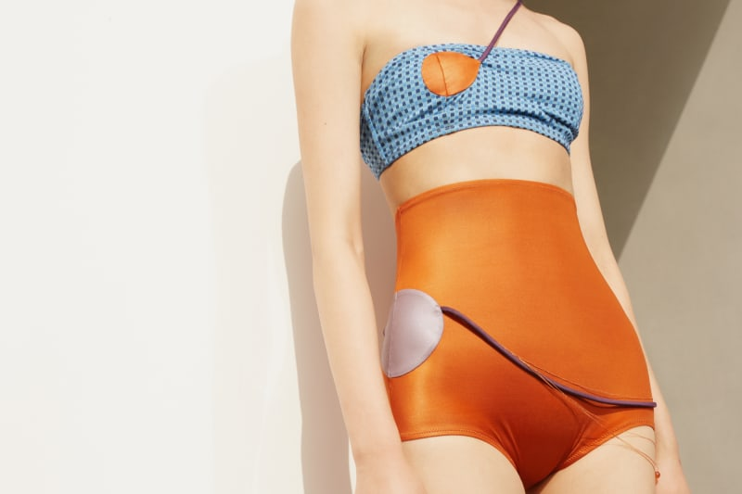
Context and Background
Fashion Contour features a high proportion of neurodivergent students (~20% estimate) (UAL, 2026)
Neurodivergence is highly represented in arts disciplines (Damiani)
Students report insecurities linked to their neurodivergence
Inclusivity and social justice are key drivers (Equality act 2010)

Slide 3
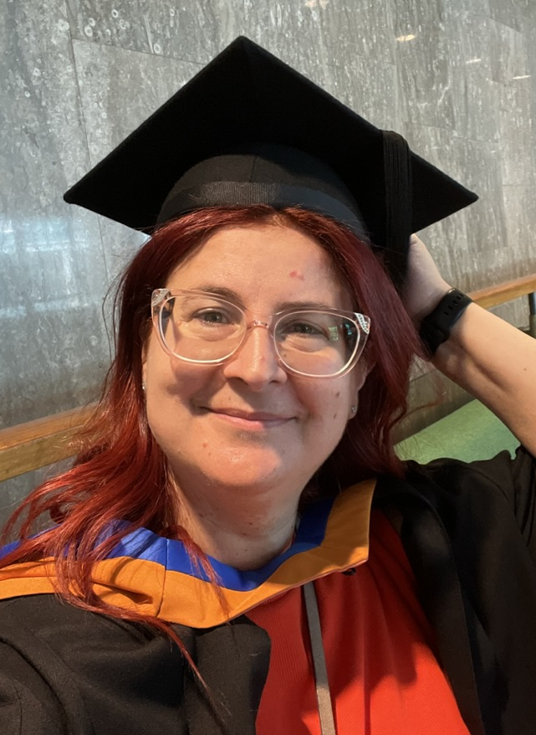
Positionality
Lecturer on the Fashion Contour course
Former student
Contour industry professional
Recognise personal privilege
Late diagnosed neurodivergent individual
  ADHD
  Dyslexia

Slide 4

Rationale
Social justice and inclusive practice
Personal and professional relevance
Need for evidence-informed approaches

Slide 5
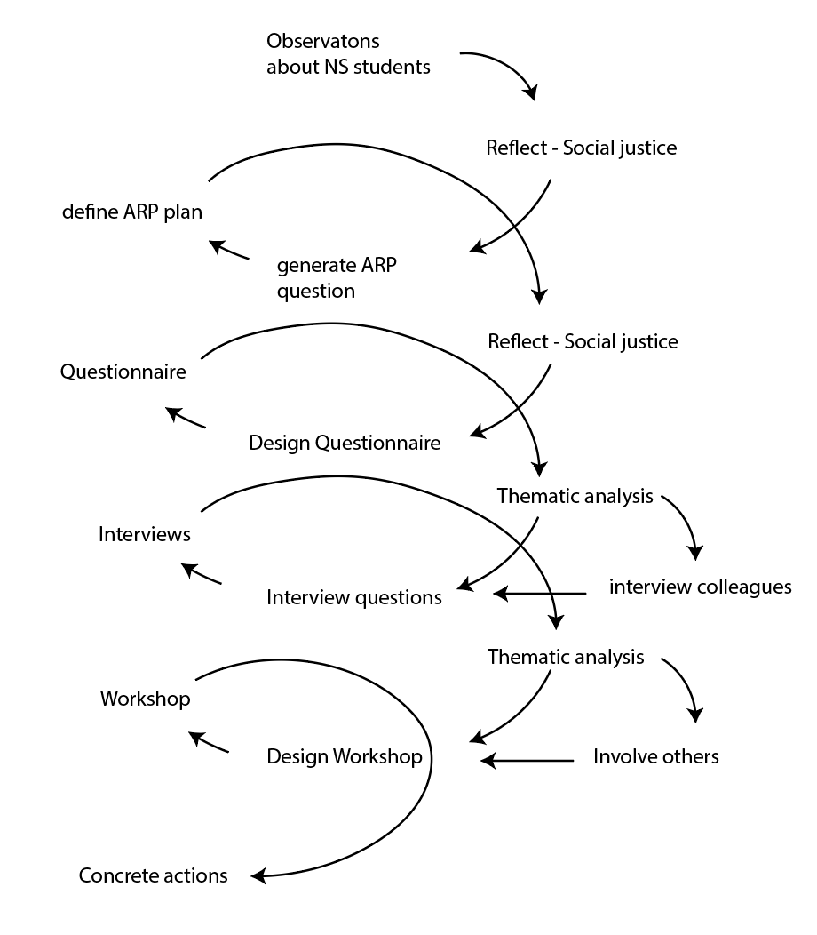
Research Methods
Questionnaire:
  Privacy
  quantitative and qualitative data
Interviews:
  open discussion
  deeper conversations
Thematic analysis (Braun, 2006)
  identify key patterns and themes
  Inform next round of questions

Slide 6

Questionnaire Findings
Dyslexia and ADHD were most commonly reported
Need for varied accommodations
Experiences of isolation emerged
Openness is welcome
Low participation suggests involving ND colleagues more actively

Slide 7

Interview Findings
Neurodivergence not viewed solely as a disability
Ongoing balance of strengths and challenges
Wide variety of accommodations required
Community spirit is empowering
Openness and dialogue are important

Slide 8

Next Step
Workshop
Co-design measures with students
Develop practical empowerment strategies

Slide 9

Actions and Improvements
Quiet hours in the machine room (implemented)
Create quieter and more welcoming spaces
Facilities and systems improvements
Improve information sharing and visibility of support

Slide 10

Reflections
Started with a positive outlook and aim for positive outcomes
Need to widen sources of information (Coyle et al, 2025)
Project highlighted value of student voice and collaboration

Slide 11
References
Braun, V., & Clarke, V. (2006). Using thematic analysis in psychology. Qualitative Research in Psychology, 3(2), 77–101. https://doi.org/10.1191/1478088706qp063oa
Coyle A, O'Hare L, Ramey D. (2025) Synapse: A co-designed neurodivergent peer support programme for higher education settings. available at https://pmc.ncbi.nlm.nih.gov/articles/PMC12159349 (accessed 20 July 2026)
Damiani L.M., On the spectrum within art and design academic practice, available at https://sparkjournal.arts.ac.uk/index.php/spark/article/view/88/146
Equality Act 2010, c. 15. Available at: https://www.legislation.gov.uk/ukpga/2010/15/contents (Accessed: 1 September 2026)
UAL, Dashboard, available at https://dashboards.arts.ac.uk/dashboard/ActiveDashboards/DashboardPage.aspx?dashboardid=e5488df0-2e0d-426d-a5fb-0a52586c4d07&dashcontextid=638675304609540356&resetFilt=true (Accessed 15 July 2026)
Disclaimer: AI was utilised to generate these slides, starting from a comprehensive script. Content is original work by the author and extensive editing has followed the initial AI generated presentation.

